Slide 1
A Lab-based Course
What to expect this semester

Slide 2


What you’re probably used to:
In Class
Lecture
Test

Slide 3


What you’re probably used to:
Outside Class
Homework & Projects
Studying for Test

Slide 4
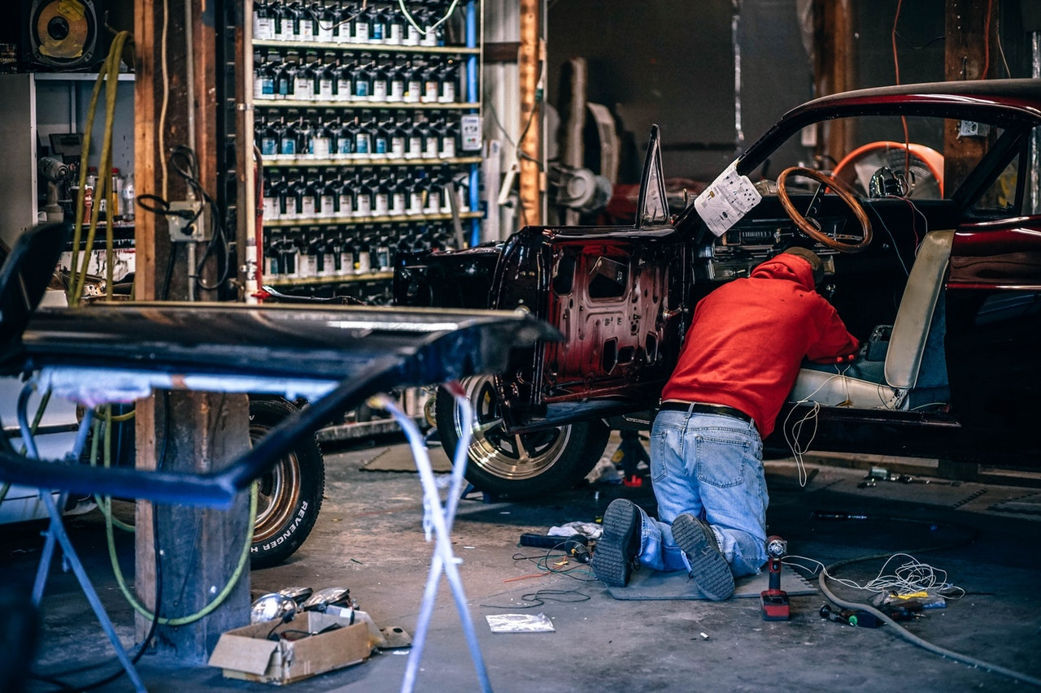
I prefer a more hands-on way of teaching.

Slide 5

During a lab-based course:
In Class
Lecture
Labs

Slide 6
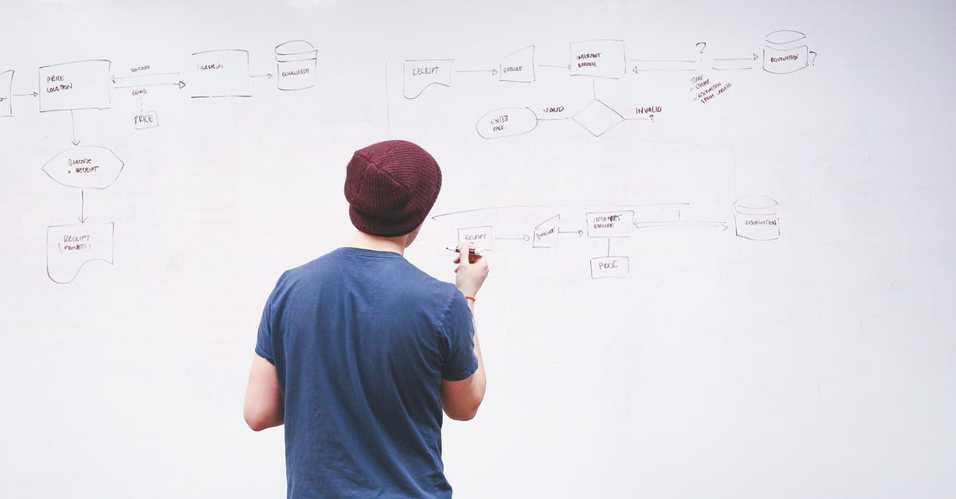
During a lab-based course:
Outside Class
Student-driven Project

Slide 7
Details
What is a lab day?
What is a student-driven project?

Slide 8
Lab Day
Be ready to work on the classroom computers
Work on your project
Help classmates with questions
Ask classmates your questions
At least every other lab I’ll set down with you individually to:
See how you are doing
Answer questions
Make suggestions
Give you a grade for that day.

Slide 9
Student-driven Project
You choose something directly related to the course as a project.
You spend hours and hours on it every week.
Be ready to show me your progress
Have a 2 minute presentation for the final day.

Slide 10
Example: One Project
Javier wants to rebuild the engine in his car. He spends hours and hours working on that every week. He shows his instructor his progress bi-weekly.

Slide 11
Example: Multiple Projects
Paola doesn’t know where to start. She spends the first weeks learning about car repair. For her project she spends hours and hours online every week reading up on what interesting to her.
Paola finally decides to turn her card into a time-travel machine. She spends hours and hours on it every week, but discovers it’s too hard for her.
Paola decides to switch to putting spinner hub caps on her car. She spends hours and hours every week doing that.

Slide 12
Bad Example
Lee wants to build a rocket out of spare blender parts. He starts working on it only to find that it’s too hard.
Lee spend the 15 minutes before class frantically doing something so he has something to show the professor.
At the end of the course, Lee just has a pile of spare blender parts.

Slide 13
How I grade the project
Out of 10 points:
10: Obviously worked hours and hours on the project. Able to talk clearly about project concepts. Can list the various tasks accomplished since the last meeting.
5: Did some work, but not hours and hours. Unable to discuss why certain decisions were made (i.e. followed a tutorial without learning anything from it). Can’t say much about what was accomplished since the last meeting.
1: Obviously crammed in something just before class.
0: Nothing to show

Slide 14
To Remember
Each lab grade is worth ~10% of your final grade.
If you missed a lab for a legitimate reason, send me a 60 second video (with audio commentary) about what you did.
If you miss a lab grading day and never come and talk to me about it, you get a 0.
Most students got 9s and 10s last semester.

